Slide 1
PROTOTYPING AND INTERFACE DESIGN
CT026-3-1-Systems Analysis and Design

Slide 2
Topic Learning Outcomes
At the end of this topic, you should be able to:
1. Discuss the objectives of input design
2. Identify the types of input design devices
3. List the guidelines of input design

Slide 3
Contents & Structure
Interface design
Guidelines for design

Slide 4
Key terms you must be able to use
If you have mastered this topic, you should be able to use the following terms correctly in your assignments and exams:
Specialty forms
Logical Design
Physical Design

Slide 5
Recap From Last Lesson
The Entity Relationship Diagram represents?

Slide 6
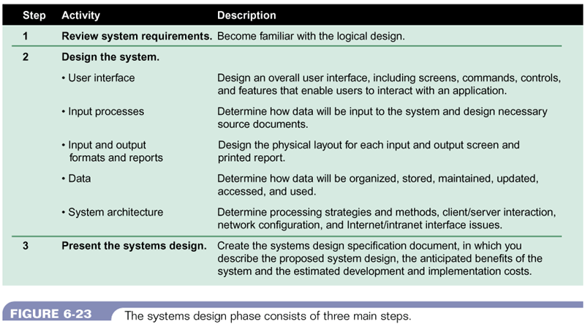
Three steps of the systems design phase
Figure 11-1 : Three steps of systems design phase
Systems Analysis & Design (4th Edition) – Shelly Cashman Series.

Slide 7
Logical Design
logical or conceptual relationships among the components of the IS
defines all
the outputs that must be produced by the system
the inputs needed by the system
the processes that must be performed by the system
is concerned with what the system must accomplish

Slide 8
Physical Design
a plan for the actual implementations of the logical design of the system
describes the implementation of all components of the Information Systems
e.g. – describes actual processes of entering, verifying, and storing data; the physical layout of data files; the sorting procedures; the exact format of the reports

Slide 9
Difference between logical and physical design
LOGICAL DESIGN | PHYSICAL DESIGN
is concerned with what is required | is concerned with how the requirements are satisfied
what data will be input to the system | how the data is input
what processes must be performed | how is the data stored and processed
what information will be output | how the output is processed
what constraints must be met | how the constraints are met
is completed during the systems analysis phase | is completed during the systems design phase

Slide 10
Input Design Objectives
Ease of use
- forms and displays are straightforward and require no extra time for users to decipher.
Effectiveness
- input forms, input displays, and fill-in forms on the Web all serve specific purposes for users of
the information system
Accuracy
- to design that ensures proper completion
Attractiveness
- implies that users will enjoy using input forms because of their appealing design.

Slide 11
Input Design Objectives
Simplicity
- keeping those same designs uncluttered in a manner that focuses the user’s attention.
Consistency
- all input forms, whether they are input displays or fill-in forms on the Web, group data
similarly from one application to the next

Slide 12
Forms
preprinted or duplicated papers that require people to fill in responses in a standardized way
serve as source documents for data entry personnel or for input to e-commerce applications
A source document collects input data, triggers or authorizes an input action, and provides a record of the original transaction.

Slide 13
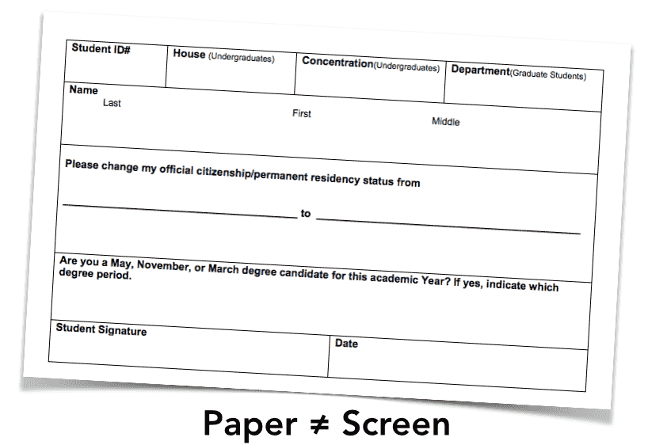

Slide 14
GUIDELINES FOR FORM DESIGN
Make forms easy to fill in
Ensure that forms meet the purpose for which they are designed
Design forms to ensure accurate completion
Keep forms attractive

Slide 15
I - Make forms easy to fill in
To reduce error, speed completion, and facilitate the entry of data, it is essential that forms be easy to fill in.
It is often possible to eliminate the process of transcribing data that are entered on a form into the system by using electronic submission.

Slide 16
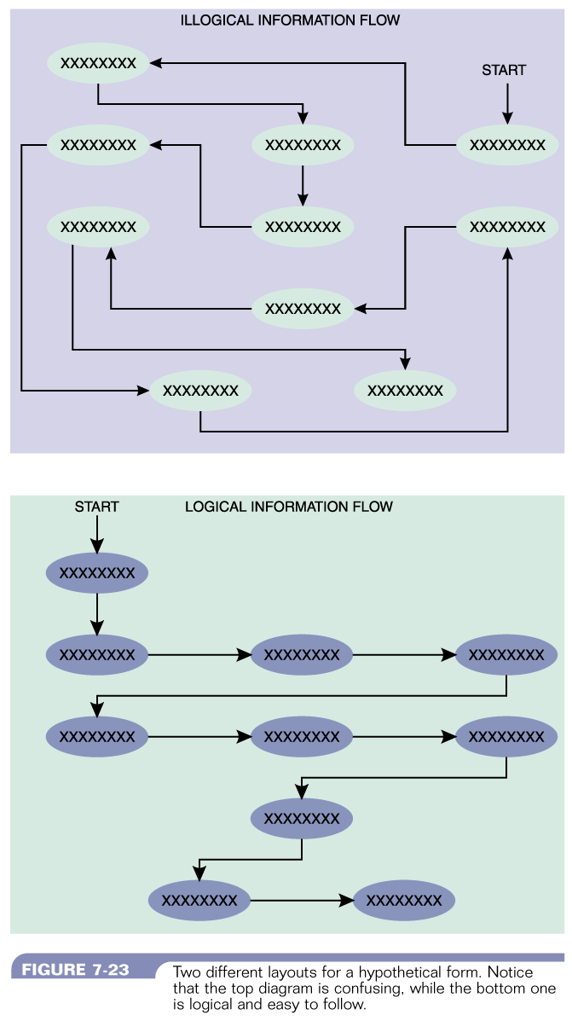
I - Make forms easy to fill in
Form Flow
Figure 11-11 : Illogical Information Flow
Systems Analysis & Design (4th Edition) – Shelly Cashman Series.
Figure 11-11 : Information Flow
Systems Analysis & Design (4th Edition) – Shelly Cashman Series.

Slide 17
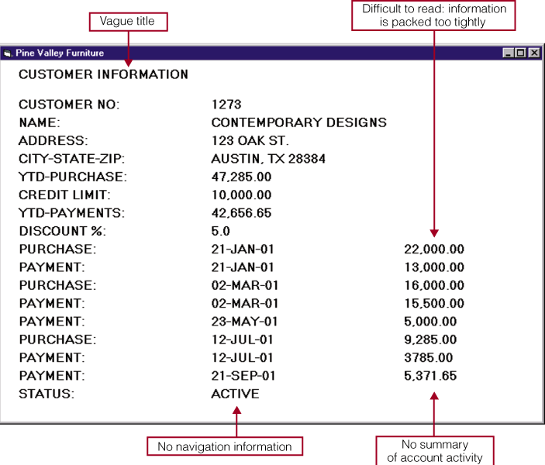
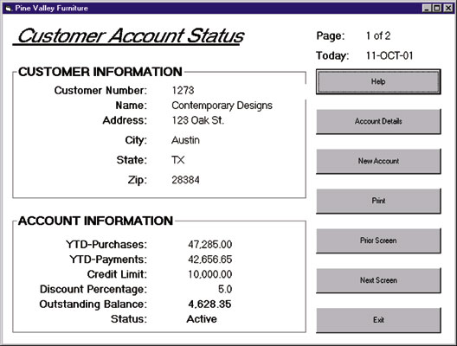
I - Make forms easy to fill in
Grouping of Information
Figure 11-11 : Illogical Grouping of Information
Systems Analysis & Design (4th Edition) – Shelly Cashman Series.
Figure 11-12 : Logical Grouping of Information
Systems Analysis & Design (4th Edition) – Shelly Cashman Series.

Slide 18
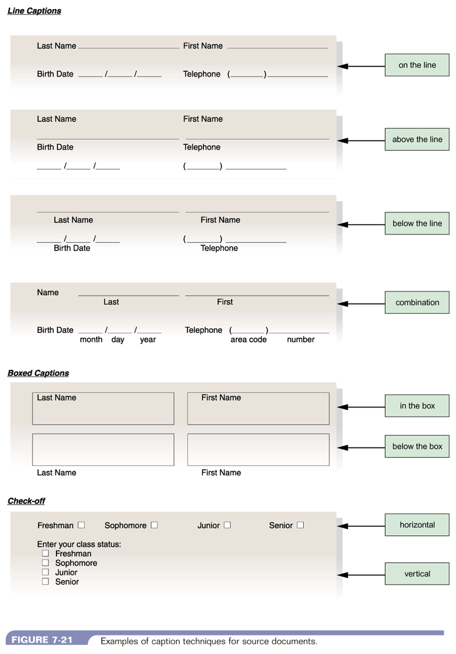
I - Make forms easy to fill in
Captions – Line Captions
Figure 11-13 : Line Captions
System Analysis and Design, 5/e - Kenneth E. Kendall & Julie E. Kendall

Slide 19
I - Make forms easy to fill in
Captions – Boxed Captions
Figure 11-14 : BoxedCaptions
System Analysis and Design, 5/e - Kenneth E. Kendall & Julie E. Kendall

Slide 20
I - Make forms easy to fill in
Captions – Check-off
Figure 11-15 : Check-ff Captions
System Analysis and Design, 5/e - Kenneth E. Kendall & Julie E. Kendall

Slide 21
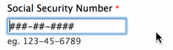
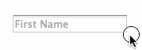

I - Make forms easy to fill in
Input Validation
Hints and Labels

Slide 22
II - Ensure that forms meet the purpose
Forms are created to serve one or more purposes in the recording, processing, storing, and retrieving of information for businesses.
forms which provide different information to different departments or users

Slide 23
III - Design form to ensure accurate completion
Error rates typically associated with collecting data will drop sharply when forms are designed to ensure accurate completion.
Design is important for ensuring that people do the right thing with the form whenever they use it.

Slide 24
IV - Keep forms attractive
forms should look uncluttered
appear organized and logical – provide enough space
follow a special order – name, street address, city, state, zip or postal code, country
Relevant data elements only- No unnecessary fields, layout & flow
suggestions
use different fonts for type within the same form
separate categories & subcategories with thick and thin lines

Slide 25
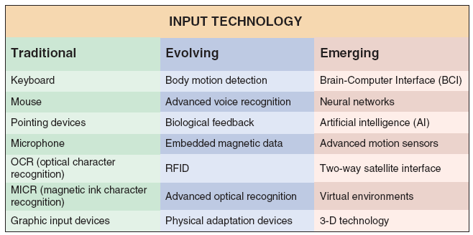
Input Technology
FIGURE 8-22 Input devices can be very traditional, or based on the latest technology

Slide 26
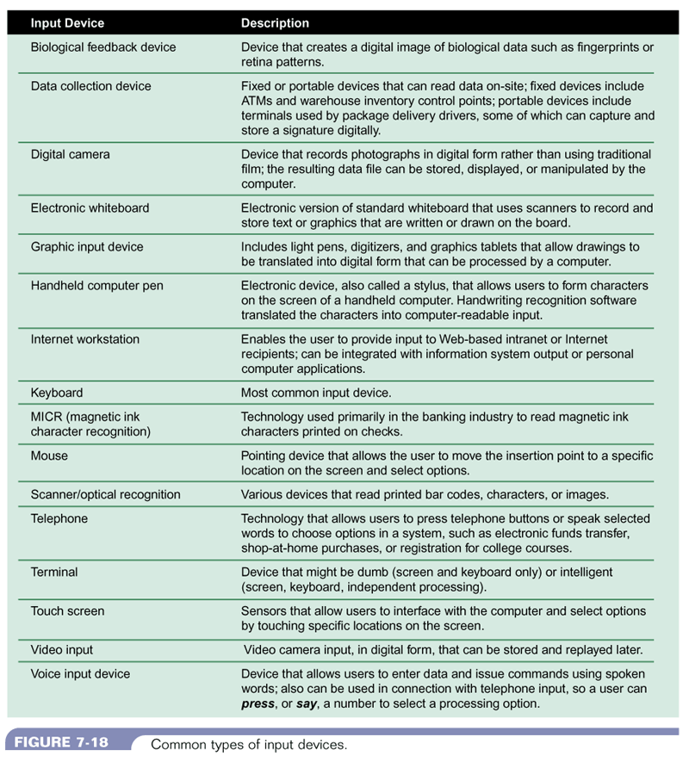
Input Device
Figure 11-8 : Input Devices – (a) Systems Analysis & Design (4th Edition) – Shelly Cashman Series.

Slide 27
Input Device
Figure 11-9 : Input Devices – (b) Systems Analysis & Design (4th Edition) – Shelly Cashman Series.

Slide 28
GUIDELINES FOR SCREEN DESIGN
Keep the screen simple
- The display should show only that which is necessary for the particular action being undertaken.
Keep the screen presentation consistent
- information that logically belongs together should be consistently grouped together.
For example, name and address go together, not name and zip code.
Facilitate user movement among screens
- Web-based forms facilitate movement with the use of hyperlinks to other relevant Web pages. Also scrolling using arrows, context-sensitive pop-up windows, or onscreen dialog.
Create an attractive screen
- Displays should draw users into them and hold their attention.

Slide 29
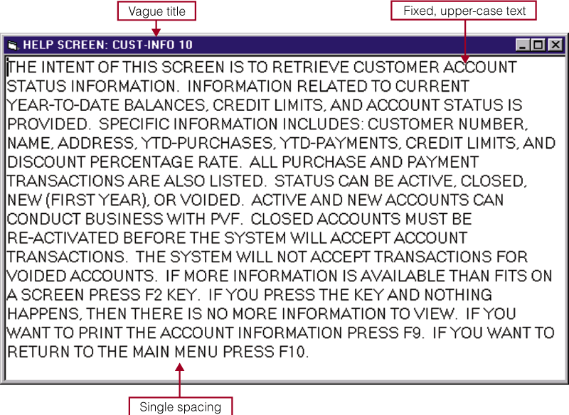
What it should not be
Figure 11-17 : Unattractive screen design Systems Analysis & Design (4th Edition) – Shelly Cashman Series.

Slide 30
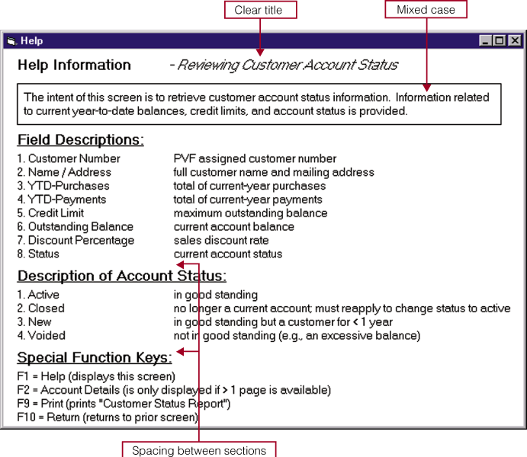
What it should be
Figure 11-18 : Attractive Screen Design Systems Analysis & Design (4th Edition) – Shelly Cashman Series.

Slide 31
Topic & Structure of the lesson
Output Design
Systems design
User Interface design

Slide 32
Learning Outcomes
By the end of this lecture, YOU should be able to :
1. Identify the objectives of output design
2. List the guidelines in output design

Slide 33
Key Terms you must be able to use
If you have mastered this topic, you should be able to use the following terms correctly in your assignments and exams:
Detail Report
Exception Report
Summary Report

Slide 34
Output Design Objectives
Designing output to serve a specific purpose
Making output meaningful to the user
Delivering the appropriate quantity of output
Providing appropriate output distribution
Providing output on time
Choosing the most effective output method

Slide 35
Guidelines in Output Design
Who is using the output?
What should the output be?
When should the output be?
How should the output be presented?
How much will it cost?

Slide 36
Guidelines in Output Design
User Involvement
Report Design Principles
Must be attractive, professional, and easy to read
Should provide totals and subtotals for numeric fields
Analyst must consider design features such as report headers and footers, page headers and footers, column headings and alignment, column spacing, field order, and grouping of detail lines
Report Headers and Footers
Every report should have a report header and a report footer
Header identifies the report, and contains the report title, date, and other necessary information
Footer can include grand totals for numeric fields and other end-of-report information

Slide 37
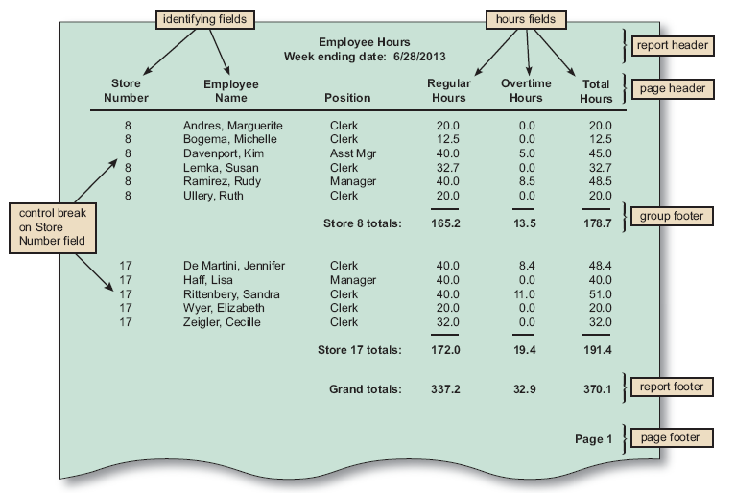
Guidelines in Output Design
FIGURE 8-20 The Employee Hours report is a detail report with control breaks, subtotals, and grand totals. Notice that a report header identifies the report, a page header contains column headings, a group footer contains subtotals for each store, a report footer contains grand totals, and a page footer identifies the page number

Slide 38
Guidelines in Output Design
Report Design Principles
Page Headers and Footers
Every page should have a report header and a report footer
Header includes the column headings that identify the data. The headings should be short but descriptive
Footer used to display the report title and the page number
Repeating Fields
The best advice is to ask users what they think and be guided accordingly
Consistent Design
Look and feel are important to users, so reports should be uniform and consistent

Slide 39
Considerations in Output Design
Main requirements in output design is that it meets the user requirements
Major function of output is to convey the information required by the user.
Therefore, the layout and design of the output is important.

Slide 40
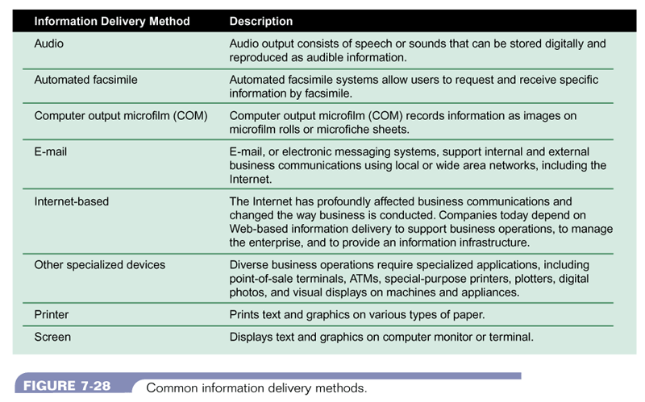
Output Methods
Figure 11-3 : Common information delivery methods
Systems Analysis & Design (4th Edition) – Shelly Cashman Series.

Slide 41
Types of Report
Types of Reports
DETAIL REPORTS
Produces one or more lines of output for each record processed
Can be quite lengthy
A better alternative might be an exception report
EXCEPTION REPORTS
Displays only those records that meet a specific condition or conditions
Useful when the user wants information only on records that might require action, but does not need to know the details
SUMMARY REPORTS
Upper-level managers often want to see total figures and do not need supporting details

Slide 42
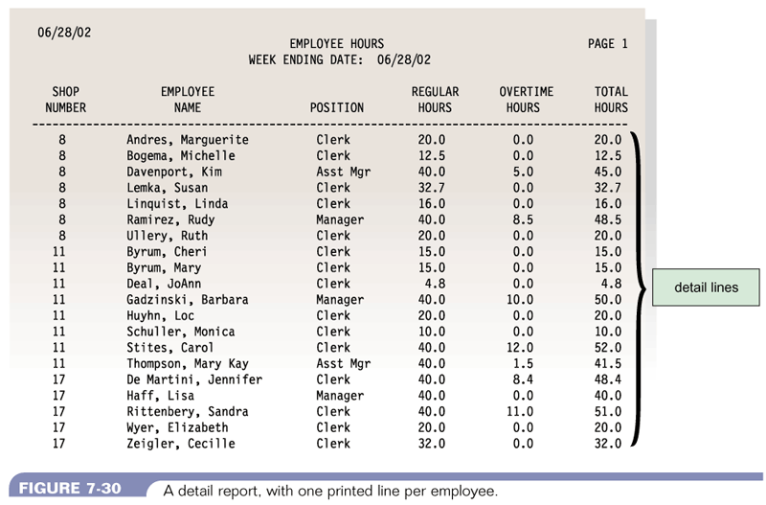
Types of Report - Detail Report
Figure 11-4 : A detail report with one printed line per employee Systems Analysis & Design (4th Edition) – Shelly Cashman Series.

Slide 43
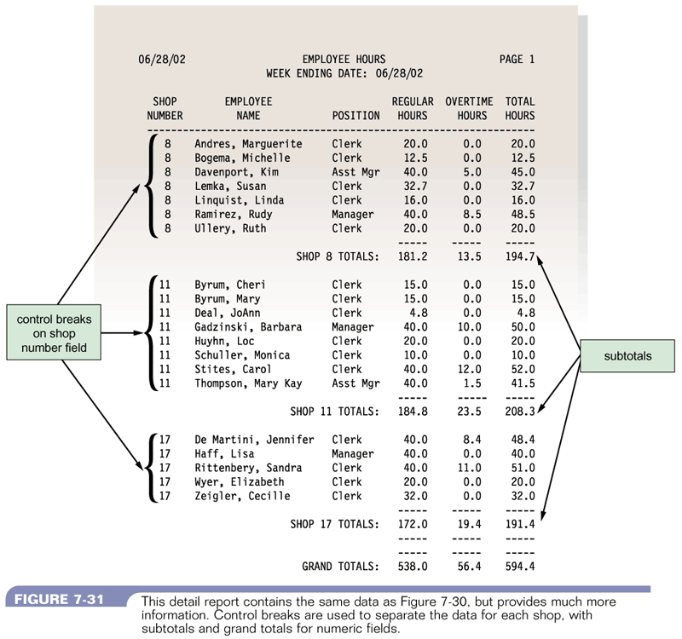
Detail Report
Figure 11-5 : A detail report with more information and using control break
Systems Analysis & Design (4th Edition) – Shelly Cashman Series.

Slide 44
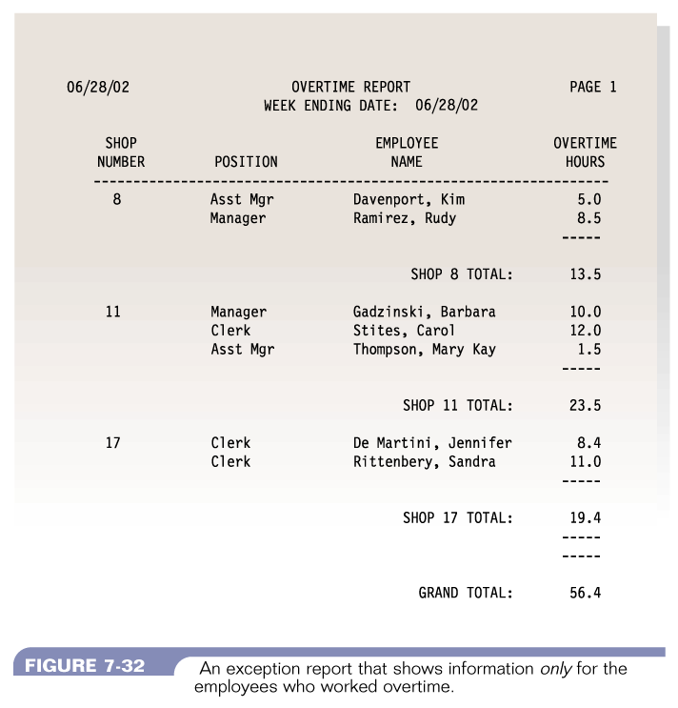
Exception Report
Figure 11-6 : A n exception report that shows information only for the employees who worked overtime Systems Analysis & Design (4th Edition) – Shelly Cashman Series.

Slide 45
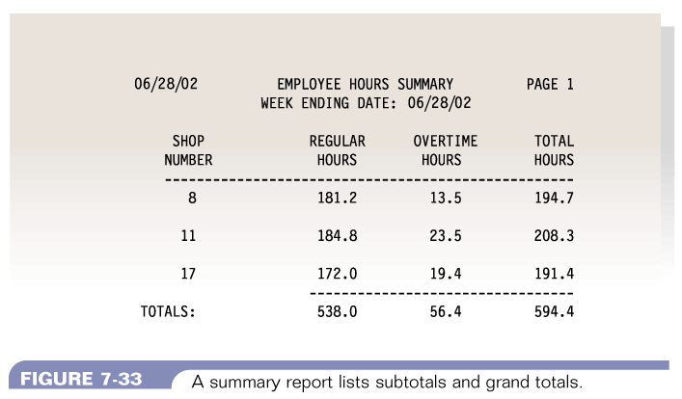
Summary Report
Figure 11-7 : A summary report lists subtotals and grand totals
Systems Analysis & Design (4th Edition) – Shelly Cashman Series.

Slide 46
Quick Review Question
The functional attributes of a printed report include:
The heading or title of the report
The page number
The date of preparation
The column headings
The grouping of related data items
All of the above.

Slide 47
Summary
Output Design
Systems design
User Interface design

Slide 48
Question and Answer Session
Q & A

Slide 49
What To Expect Next Week
In Class
Preparation for Class
Implementation and testing
Download the slide and study for the next chapter.

